Slide 1
GitHub Essentials
With Visual Studio 2022

Slide 2
Best advice…
KEEP IT SIMPLE!!
Define a simple protocol for using GitHub, and stick to it.
Be very careful about multiple persons working on same files.
GitHub doesn’t replace communication and common sense…

Slide 3
Main concepts
Git. Source code version control software.
GitHub. Website for storing source code repositories online (a UI for Git).
Repository. A single named source code storage unit (essentially a folder).
Origin: The instance of the repository on GitHub
Local repository: The instance of the repository on your own local PC
Branches: Named versions of a repository
Master: The “main” branch of a repository

Slide 4
Main concepts
Branches will be different from each other
The master branch is “the truth”. Other branches will exist for a certain period of time, but will ultimately be merged into the master branch.
In Visual Studio, the Git menu and the Git Changes view are your main tools for managing source code control with GitHub.

Slide 5
GitHub (person A)
Repository
(person A,
invites person B)
Master
Creates
Clones
Person A local PC
Person B local PC
Repository
Repository
Master
Master

Slide 6
Single person (master branch only)
Person A creates new VS project
Person A adds to Source control (local + GitHub repo created)
Person A can update code, commit and push (to master branch)
Remember: getting code from local PC to GitHub repository is a two-step procedure:
Commit changes (to local repository)
Push commit to Origin (i.e. to GitHub repository)

Slide 7
GitHub (person A)
Repository
Master
Push
Person A local PC
Source code
Repository
Master
Commit

Slide 8
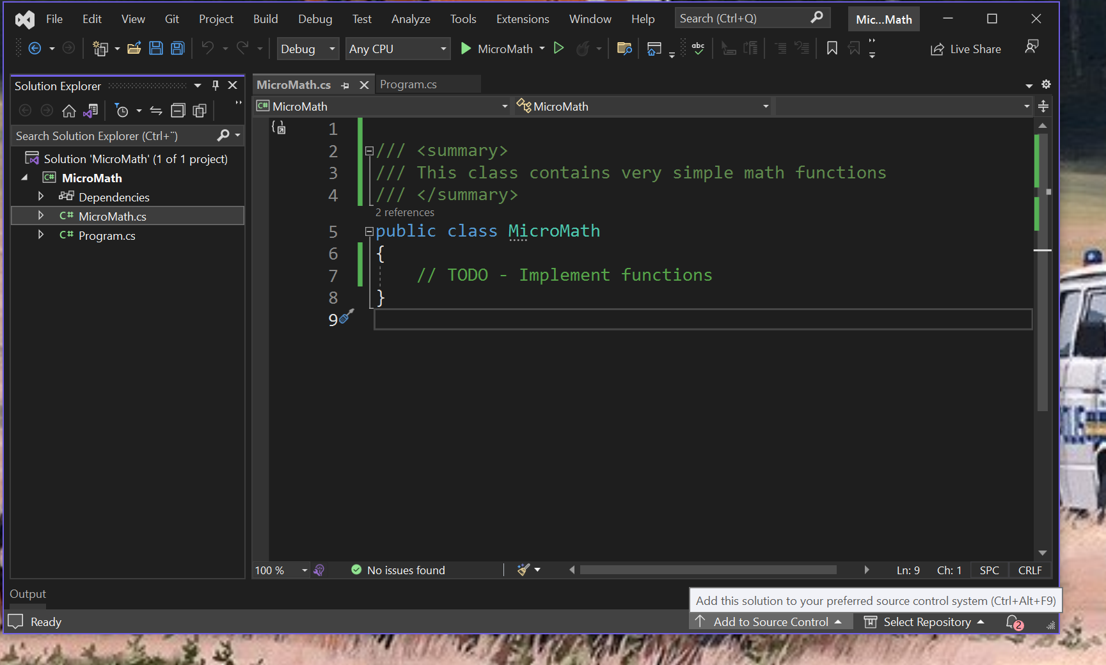

Slide 9
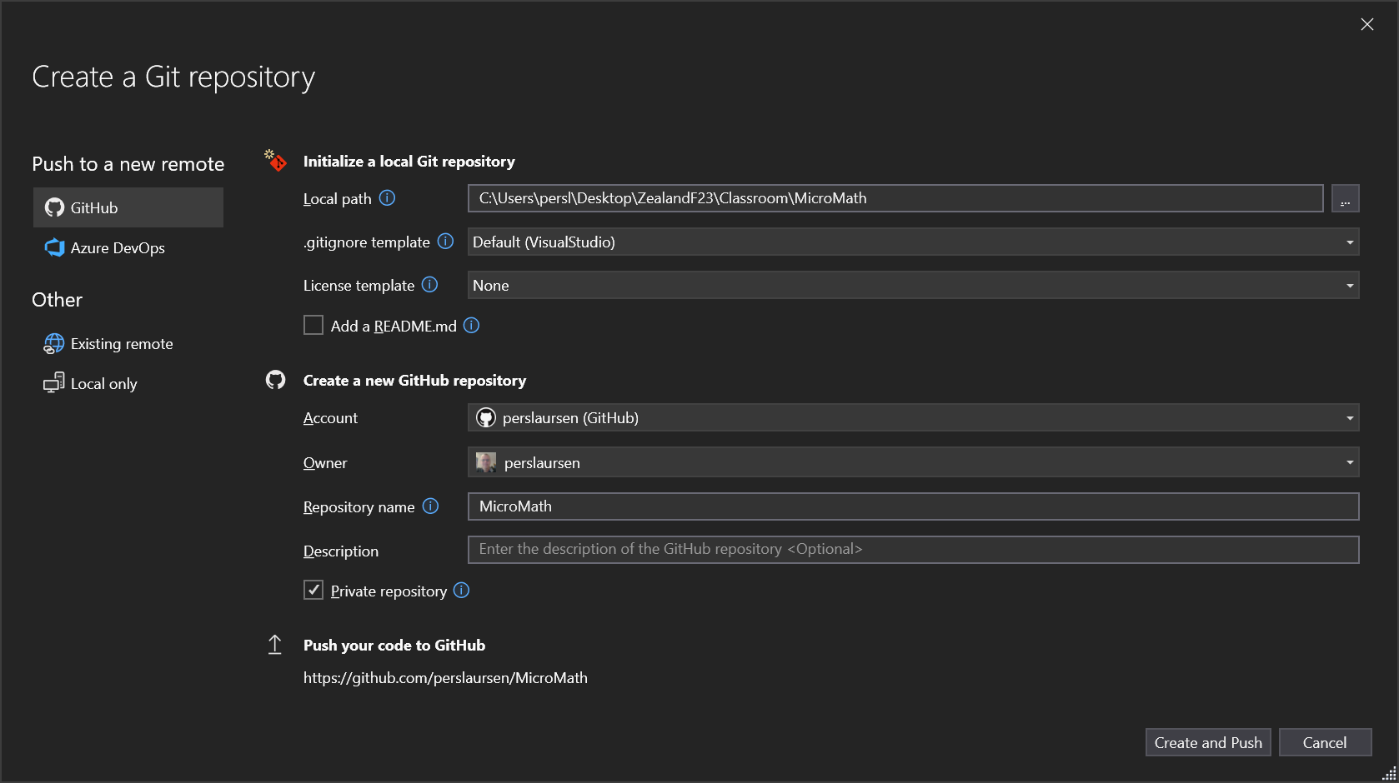

Slide 10
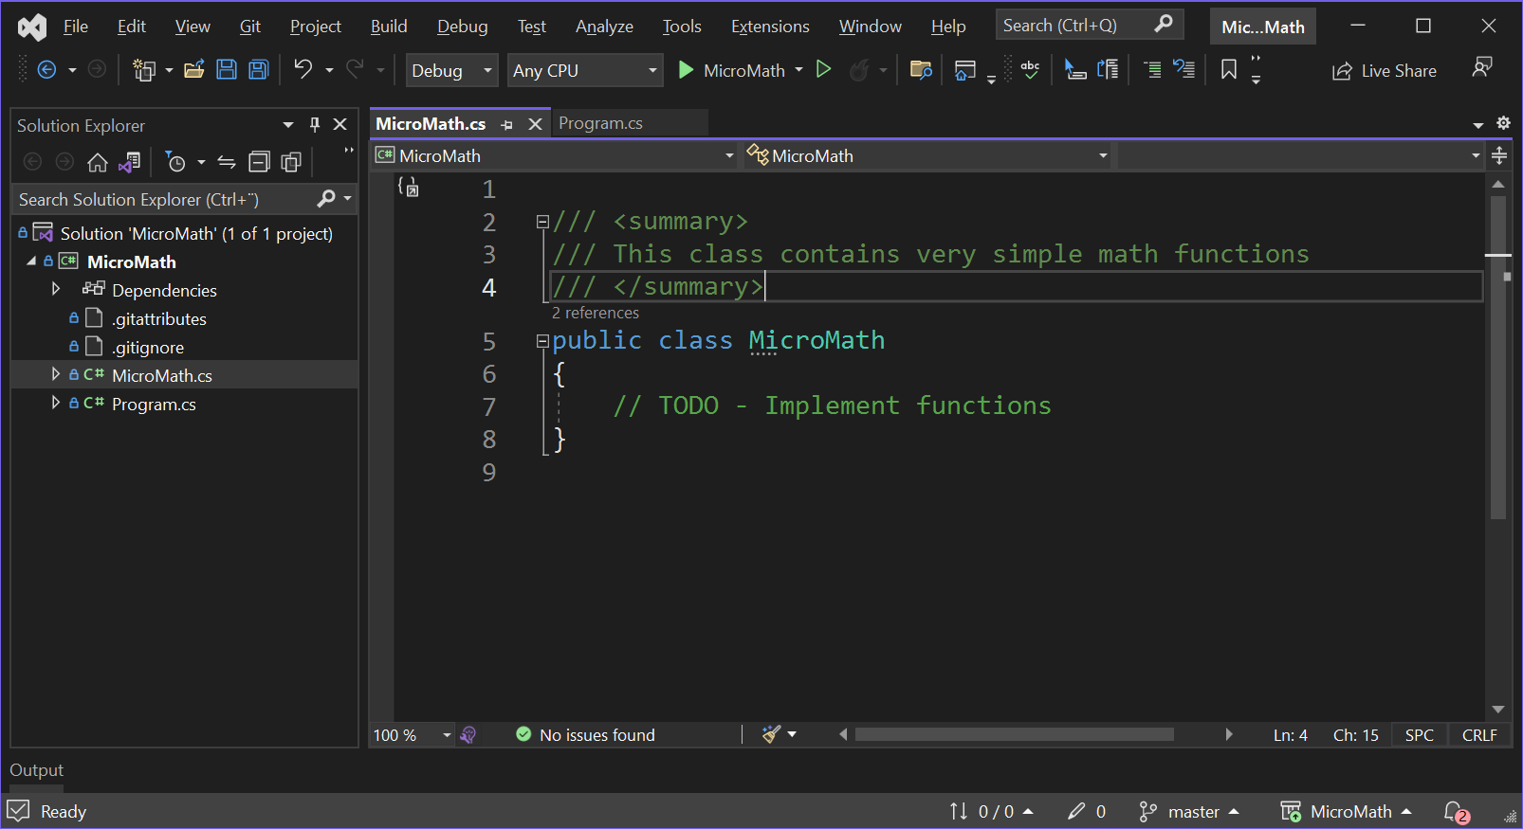

Slide 11
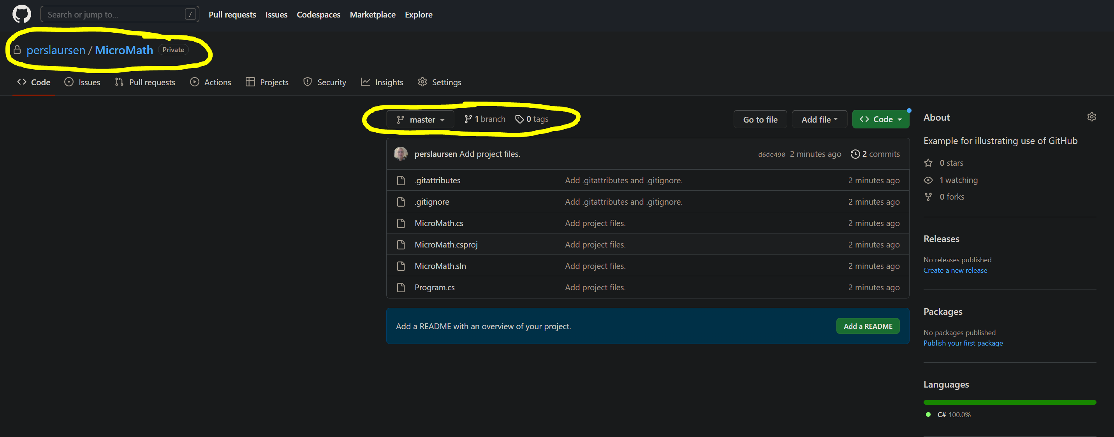

Slide 12
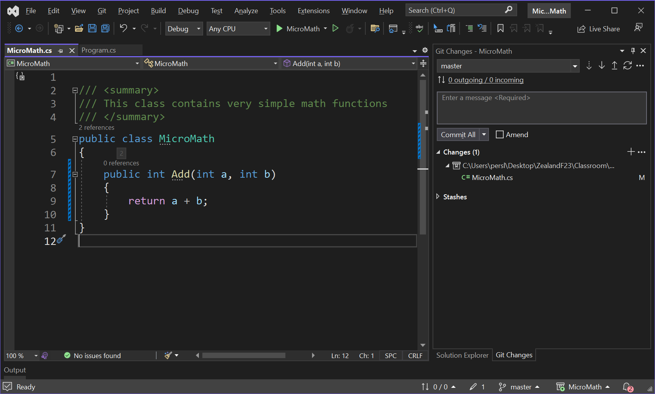

Slide 13
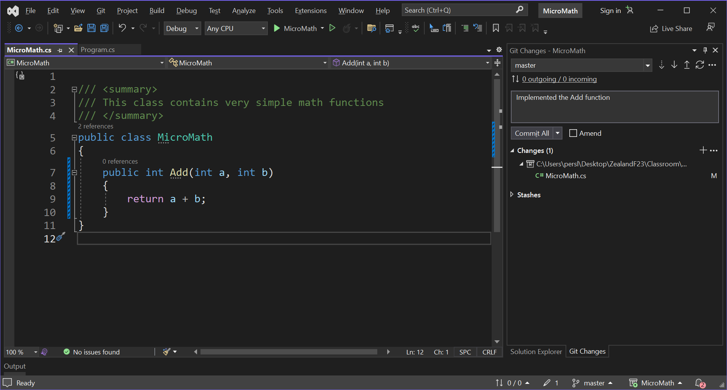

Slide 14
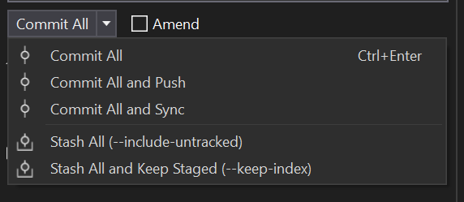

Slide 15
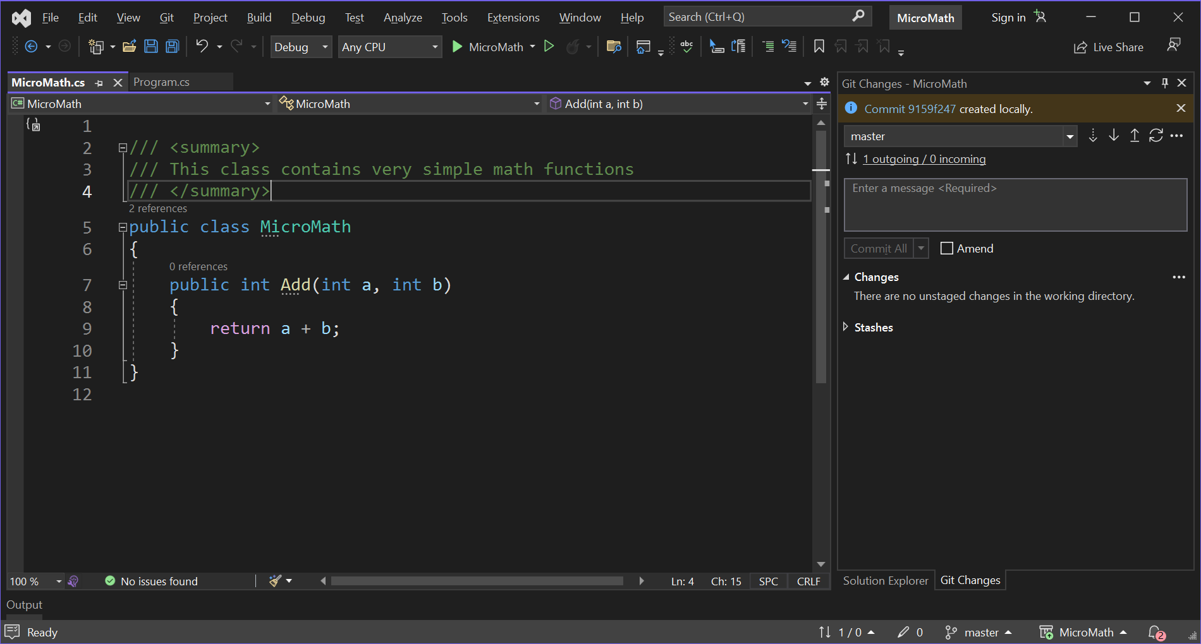


Slide 16
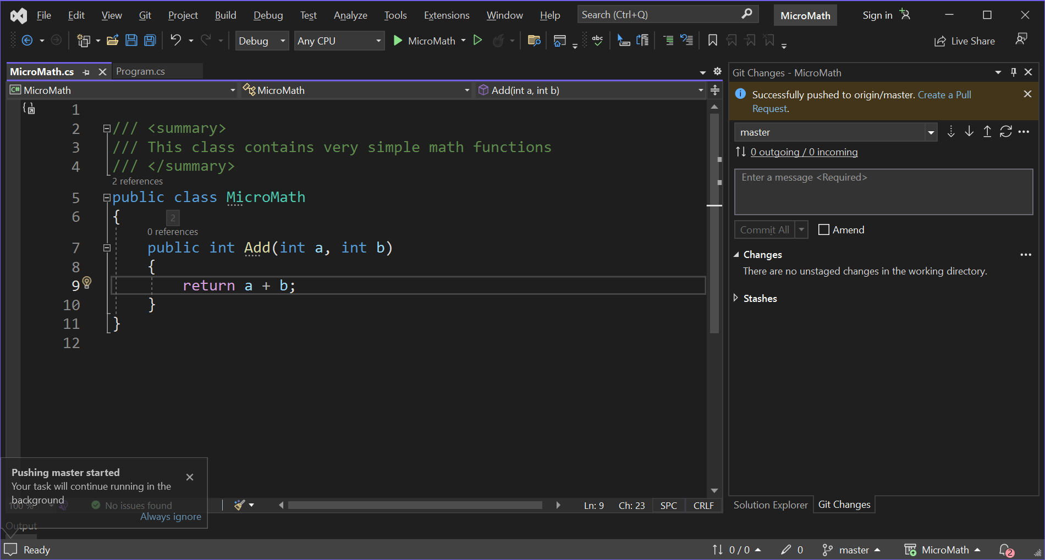

Slide 17
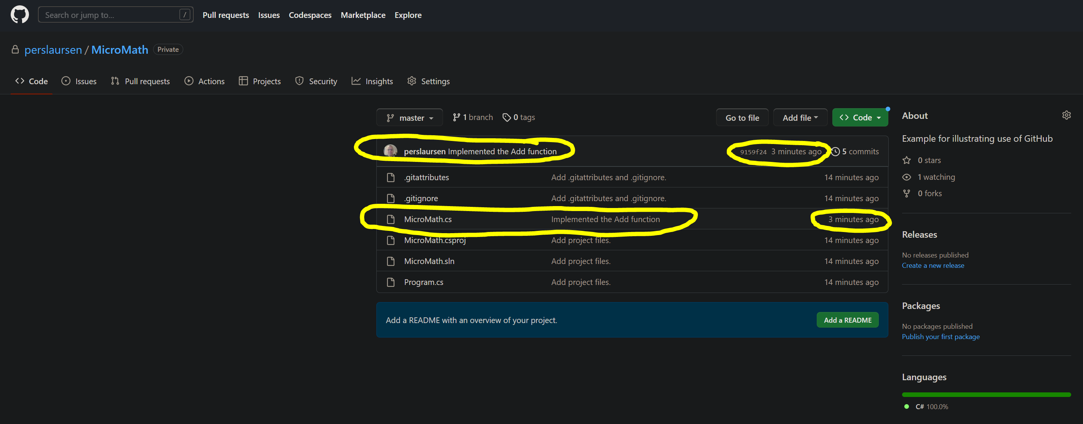

Slide 18
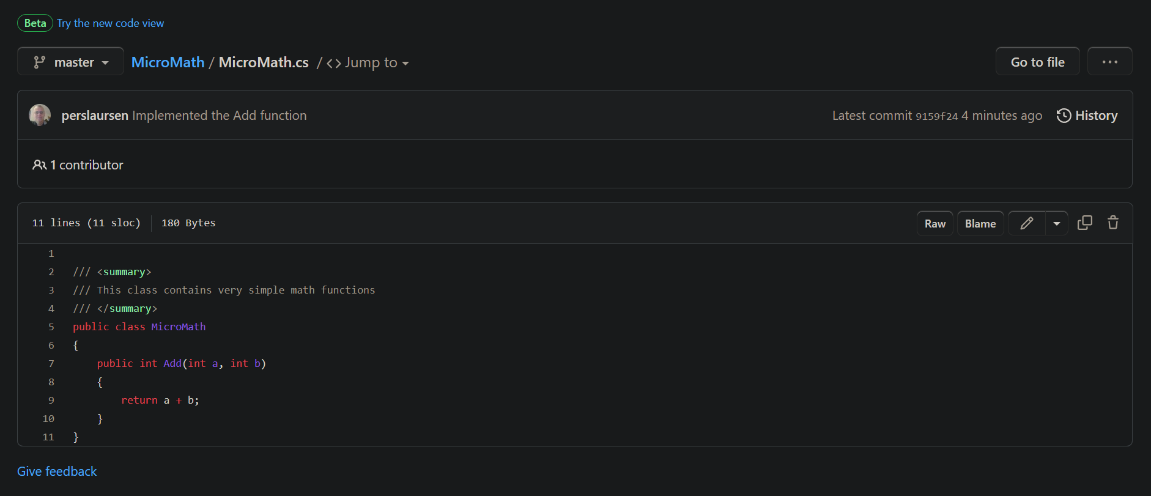

Slide 19
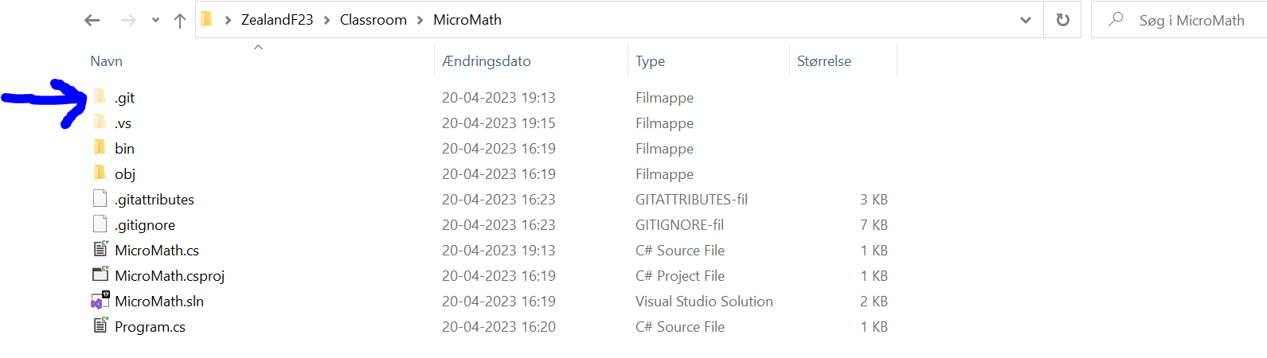
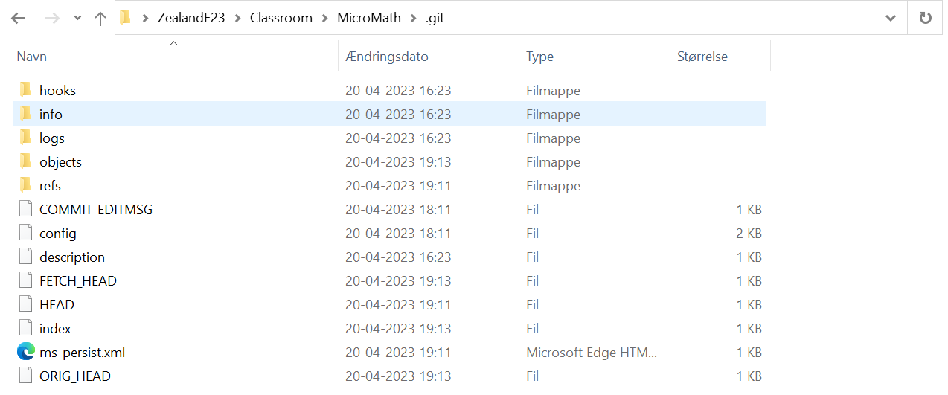
Where is my (local) repository…!?
On your local PC, you have two logical entities
Your source code
Your repository
The repository is physically represented by a hidden folder named .git in your source code folder

Slide 20
Two (or more) persons (master branch only)
Person A invites Person B to be a collaborator on repository
Person B accepts invitation
Person B can now (in VS) clone repository (cloning is done once)
Person B can update code, commit and push (to master branch)

Slide 21
GitHub (person A)
Repository
Master
Clone
Person B local PC
Repository
Master

Slide 22
GitHub (person A)
Repository
Master
Push
Person B local PC
Source code
Repository
Master
Commit

Slide 23
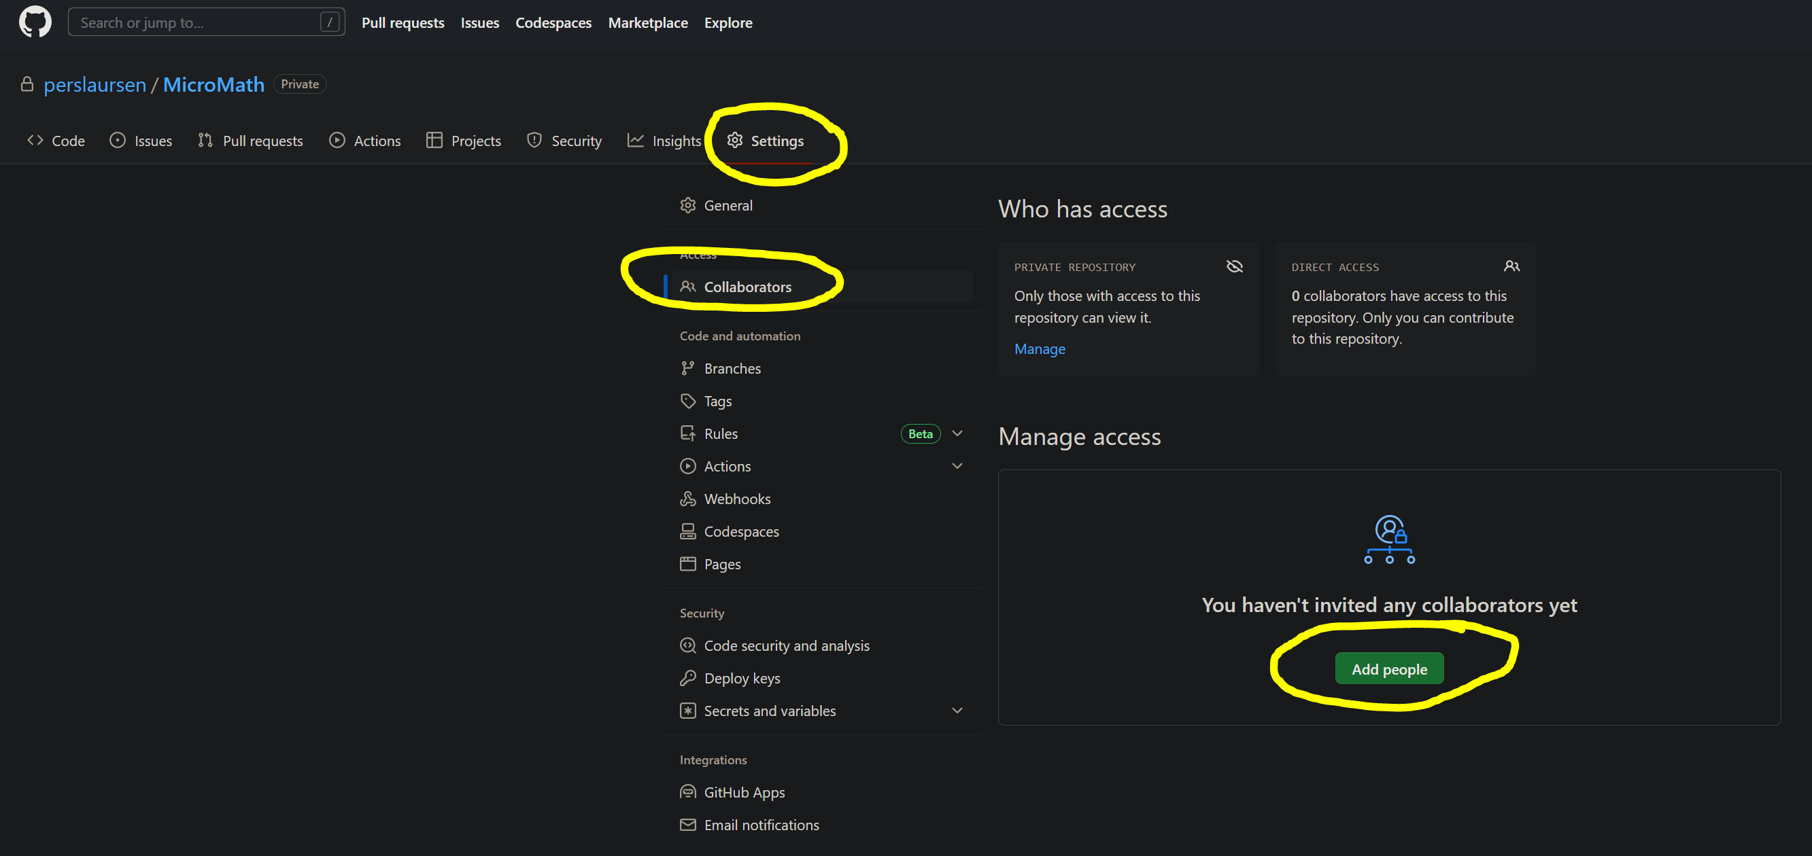

Slide 24
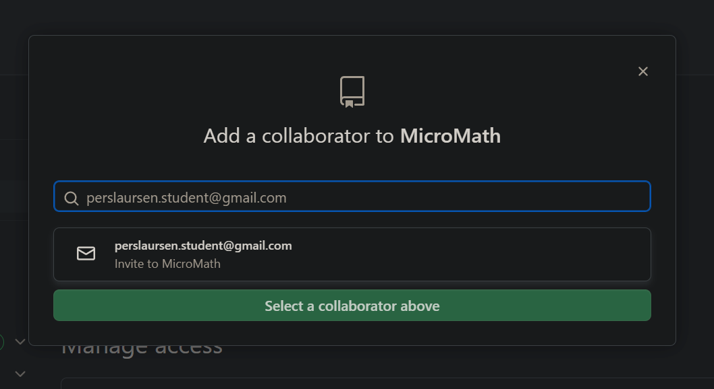

Slide 25
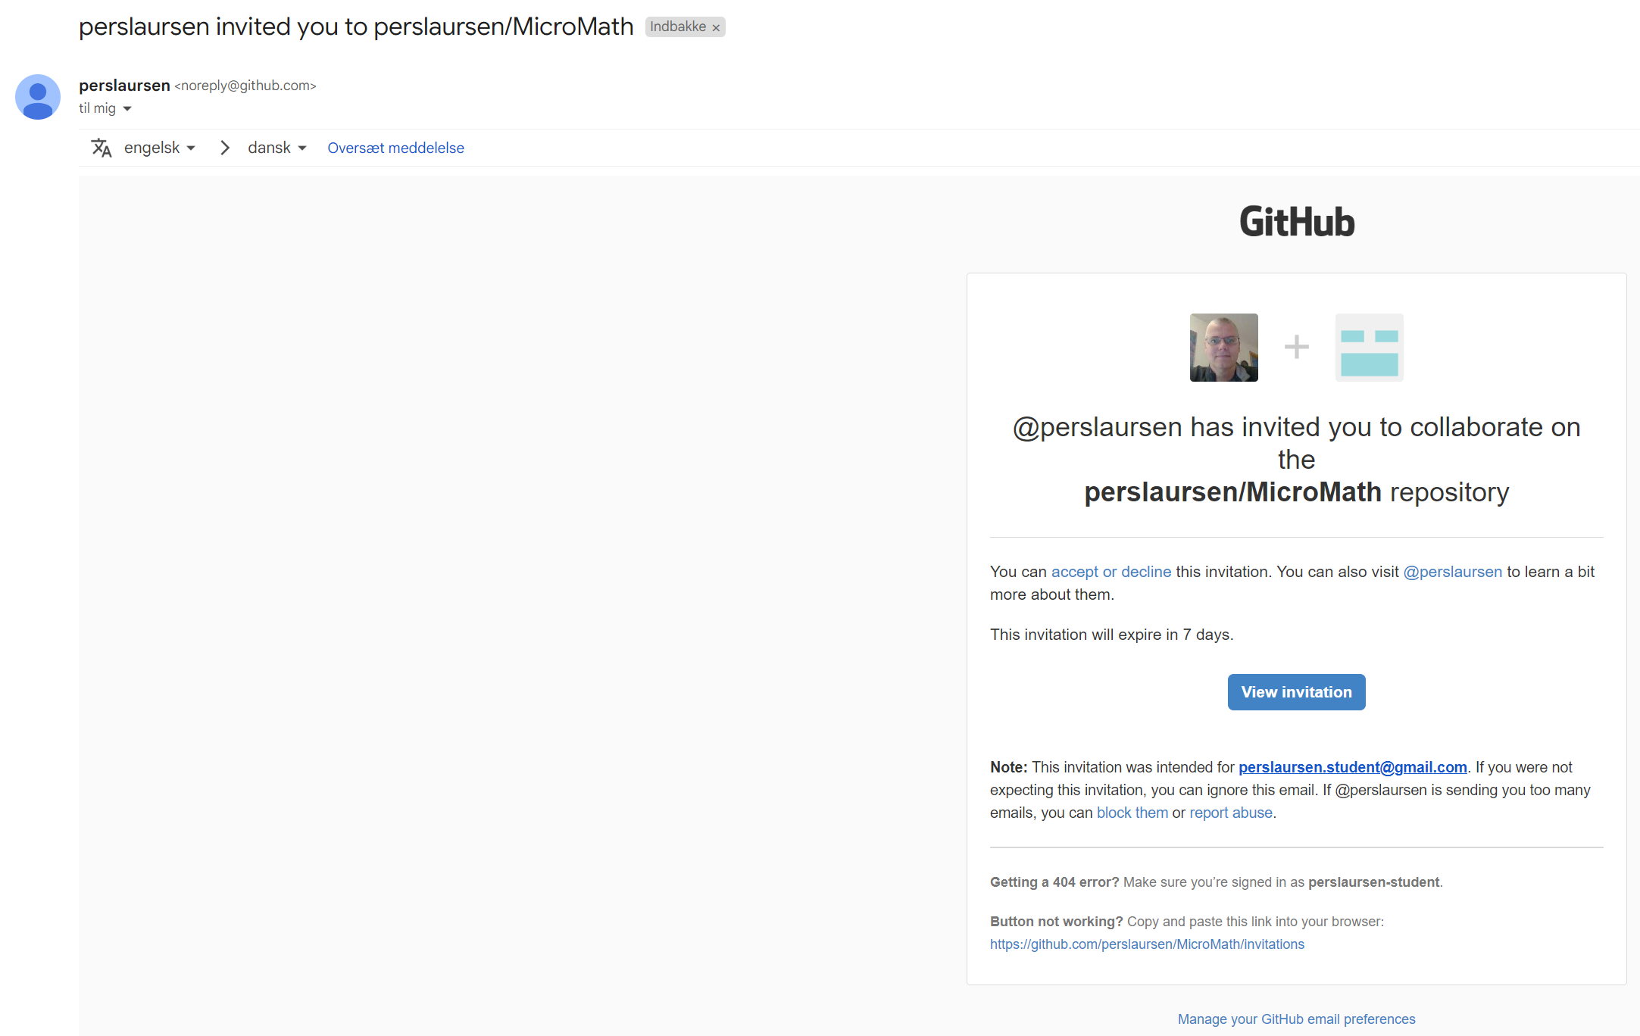
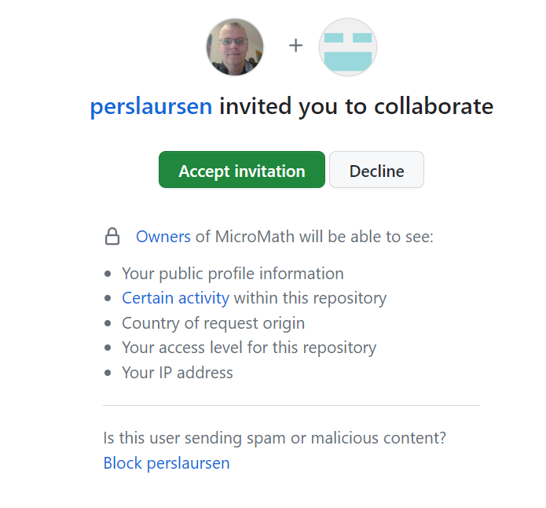

Slide 26
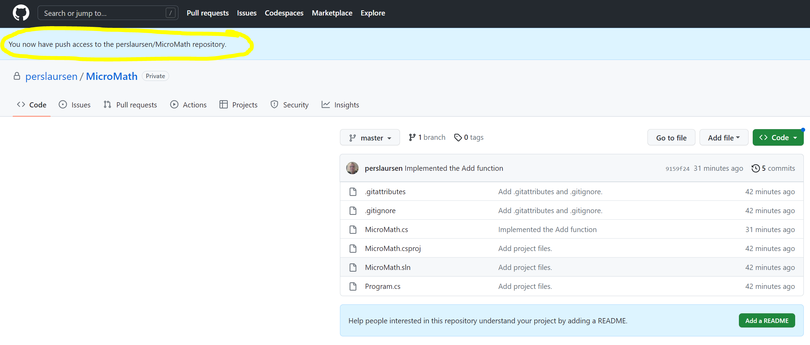

Slide 27
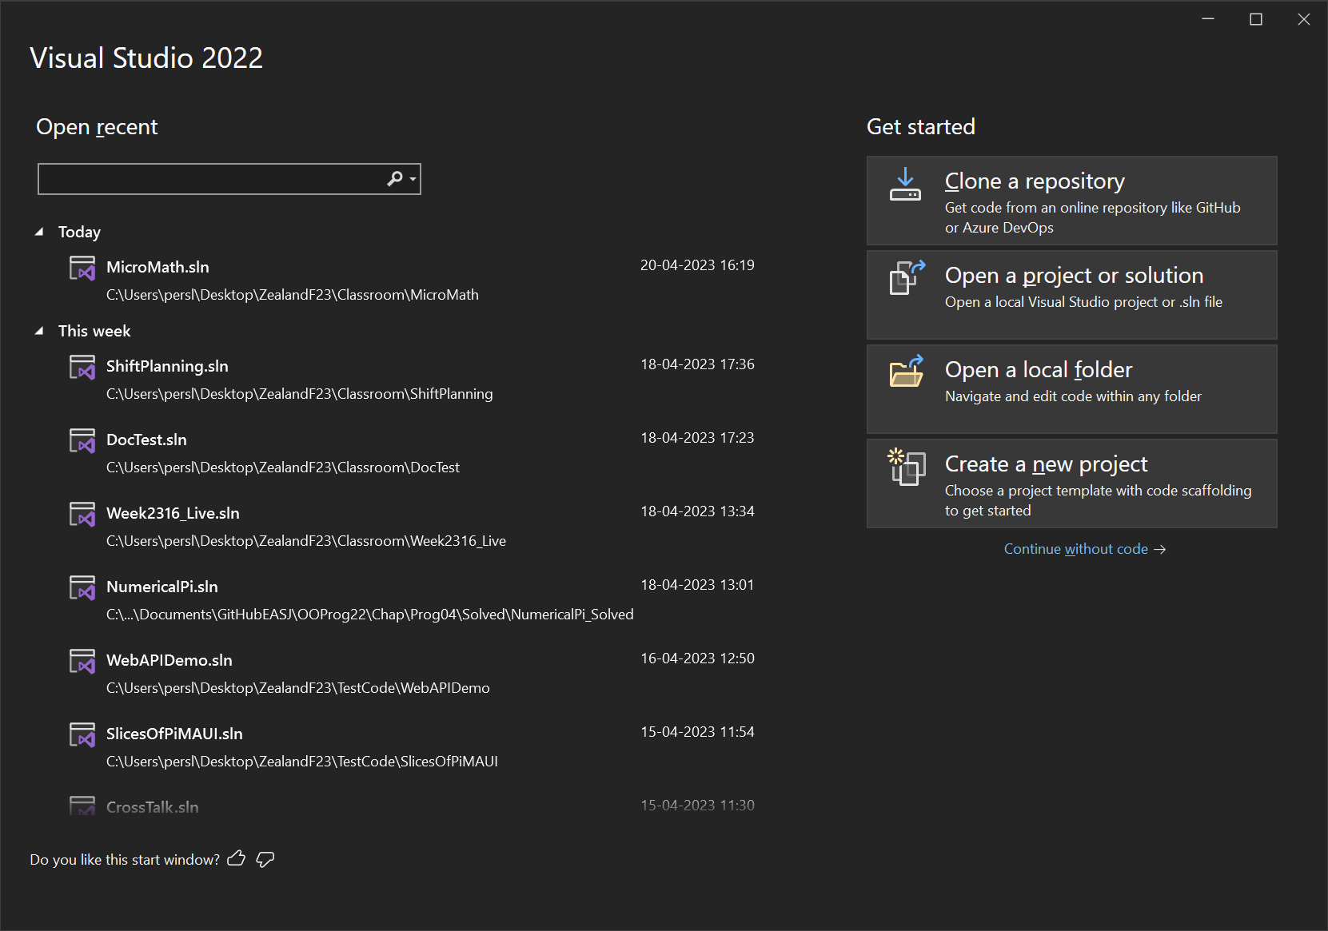

Slide 28
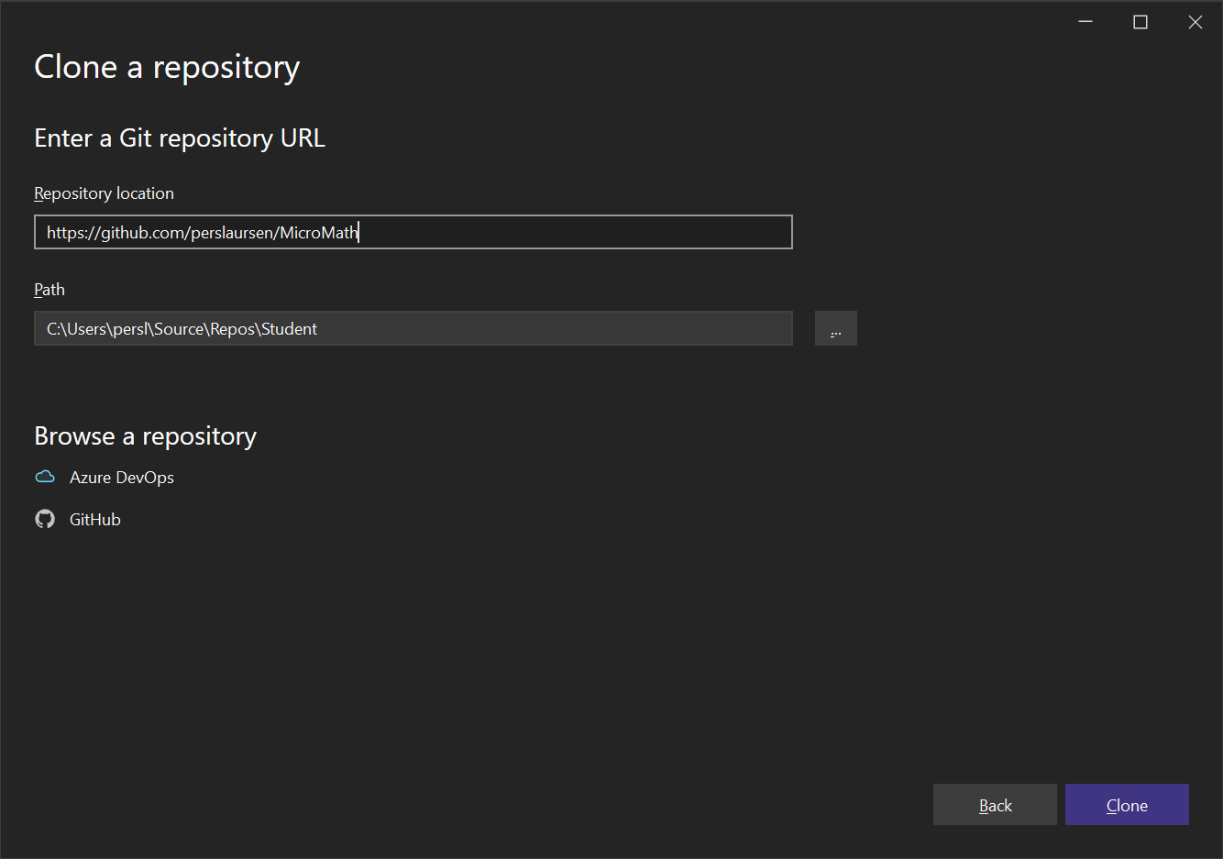

Slide 29
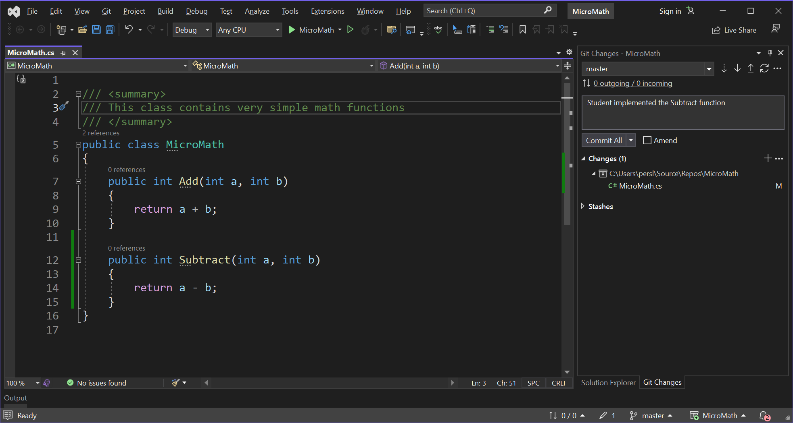

Slide 30
One person, using branches
Person A creates a new branch to implement a new feature
Person A implements new feature (in new branch)
Person A commits and pushes the new feature (in new branch)
Person A creates a pull request concerning the new branch (NB: You can do several commits/push on a branch before creating a pull request)
Pull Request: Request that a named branch is merged into the master branch. The named branch is often deleted afterwards.

Slide 31
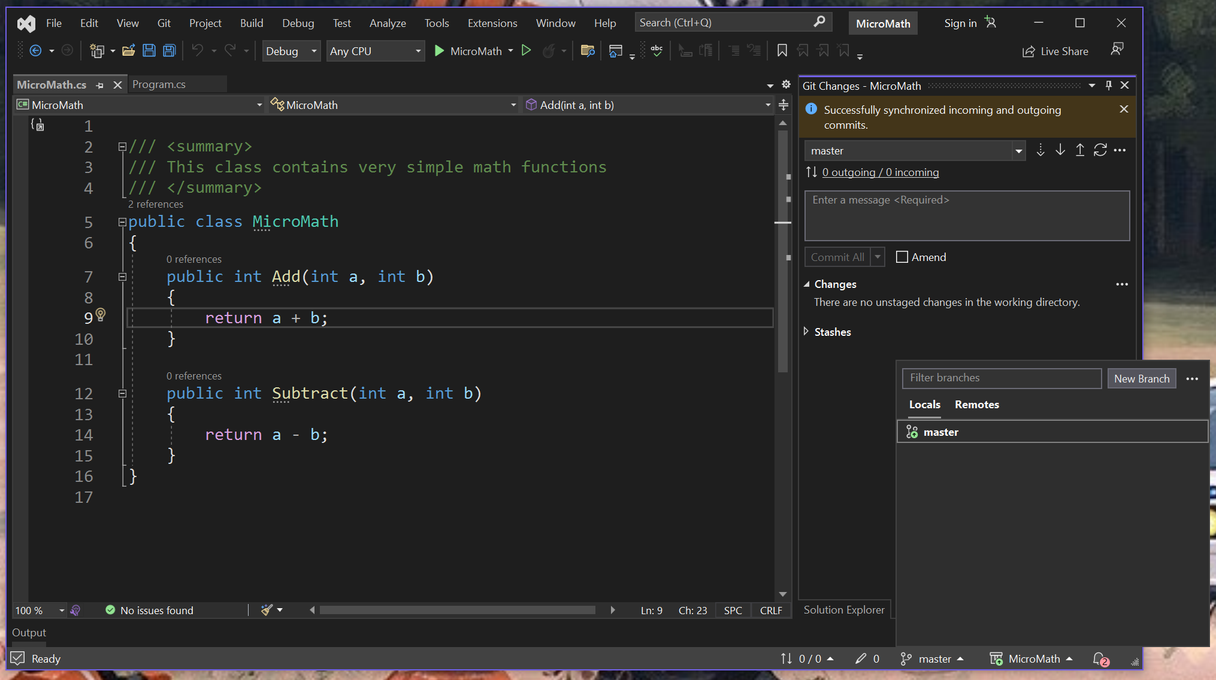

Slide 32
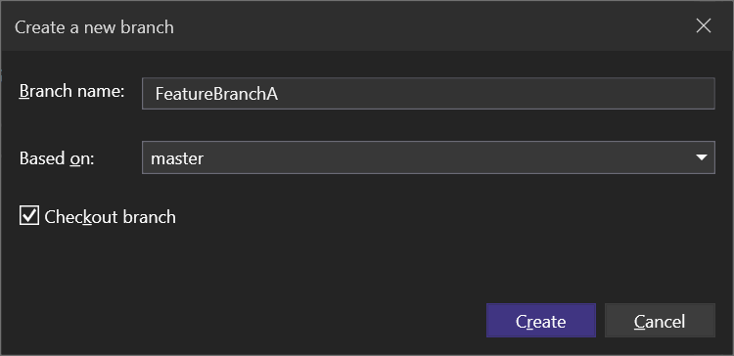

Slide 33
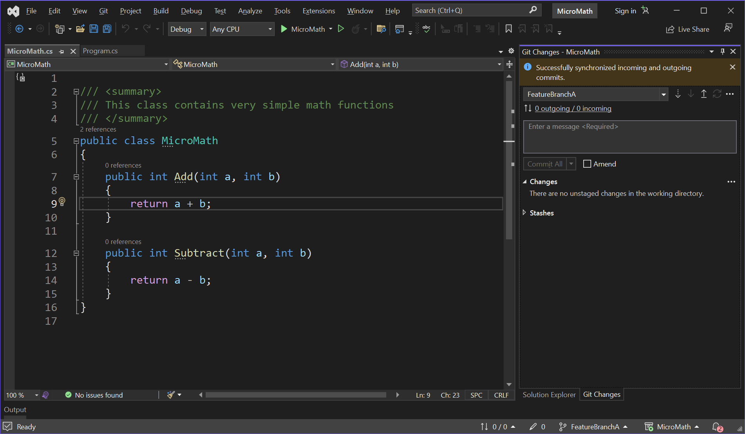

Slide 34
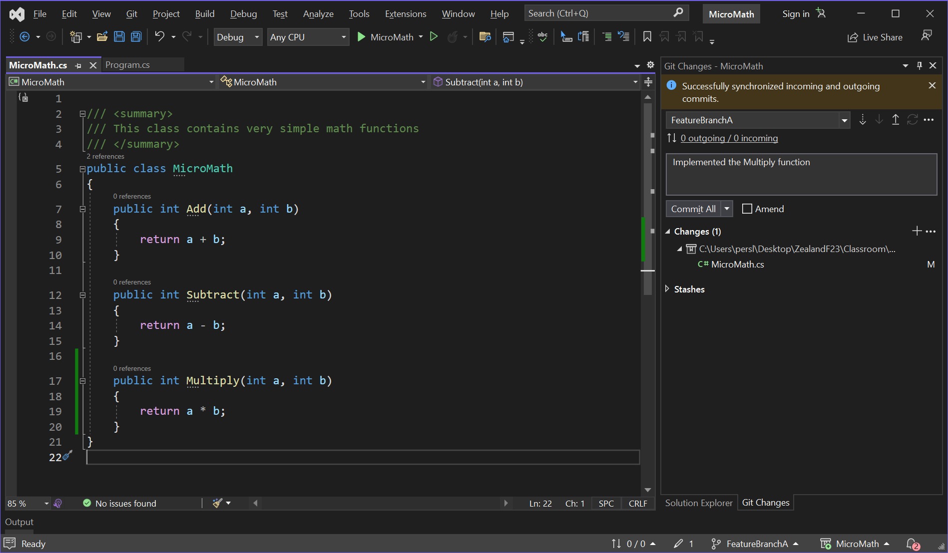

Slide 35
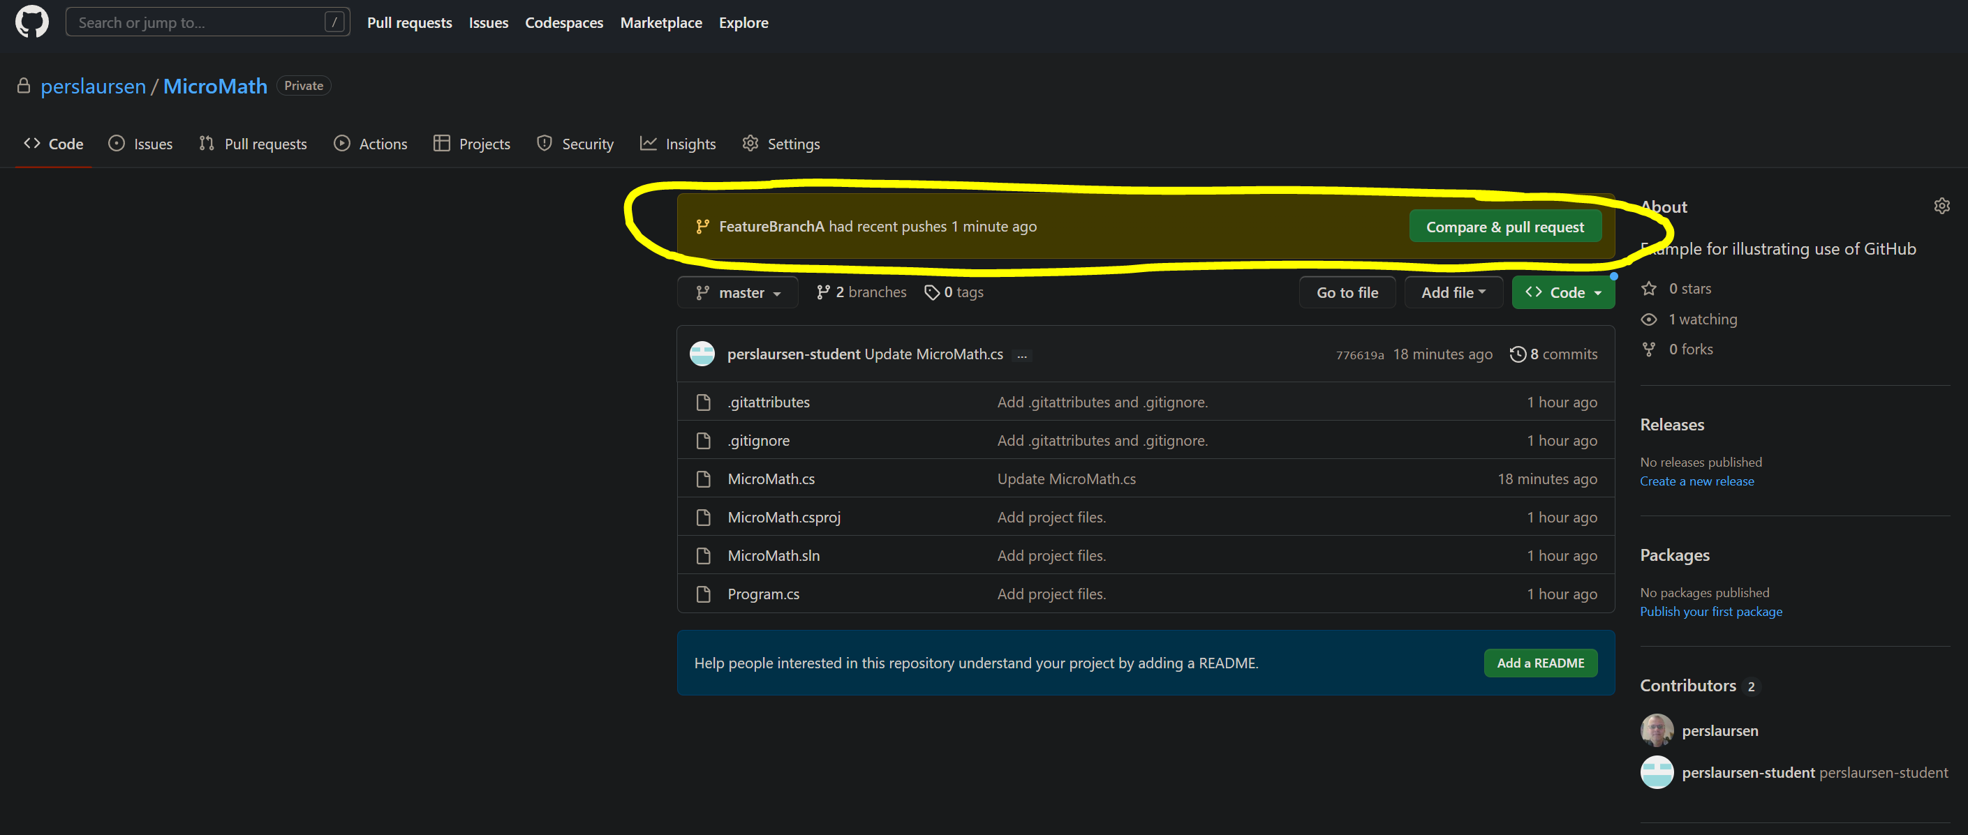

Slide 36
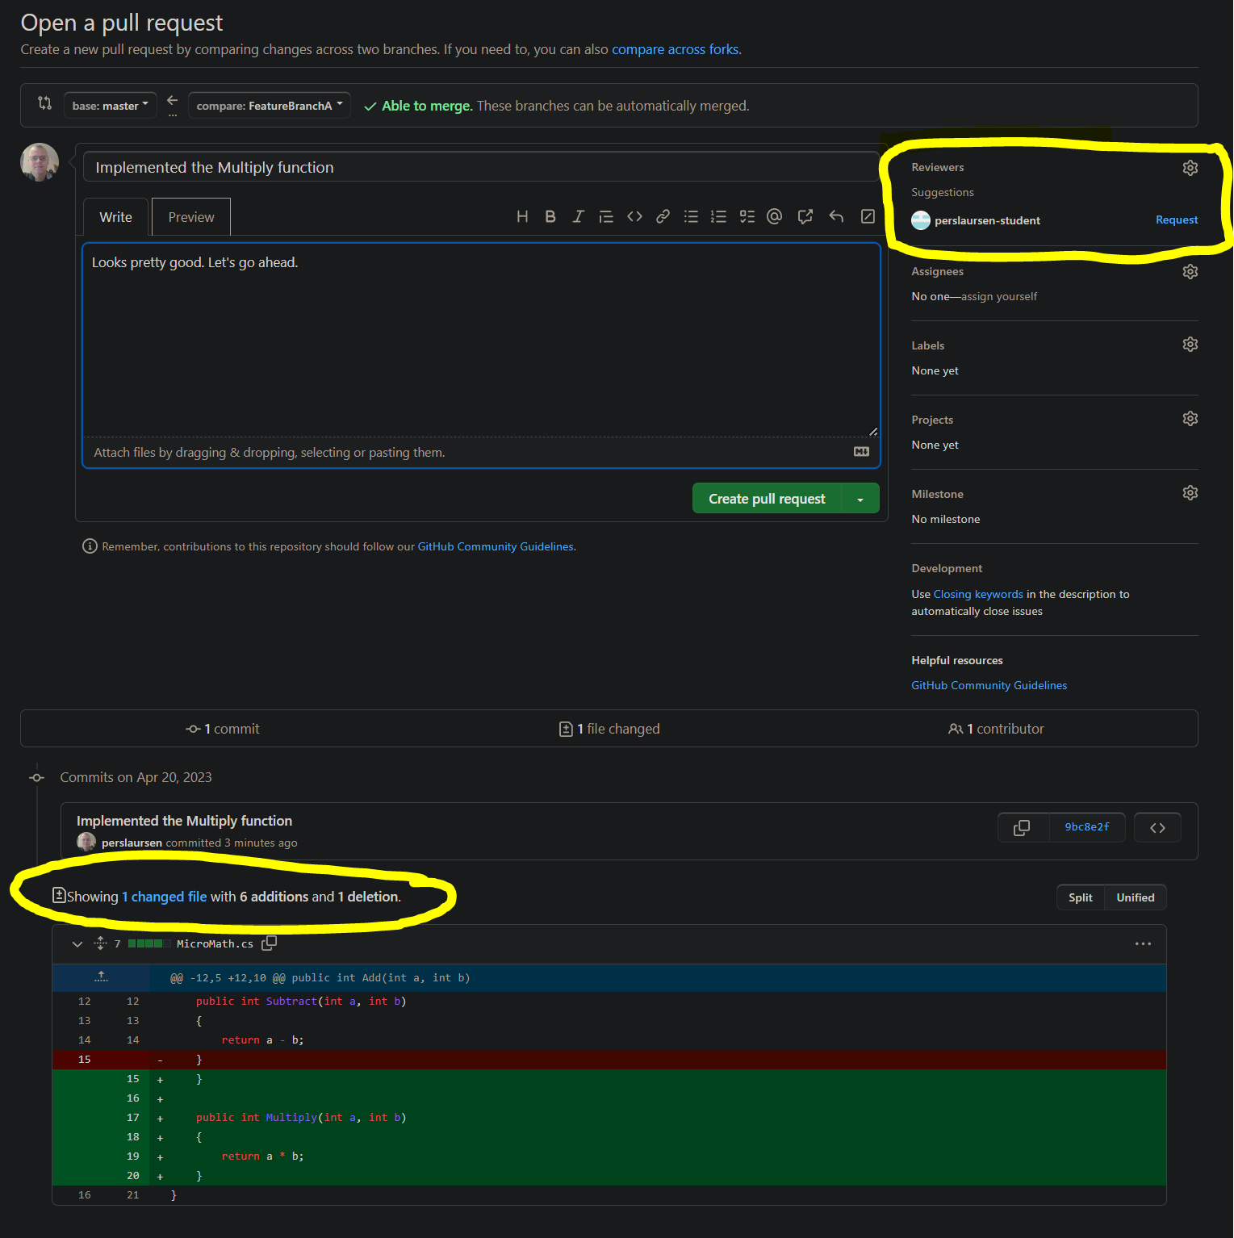

Slide 37
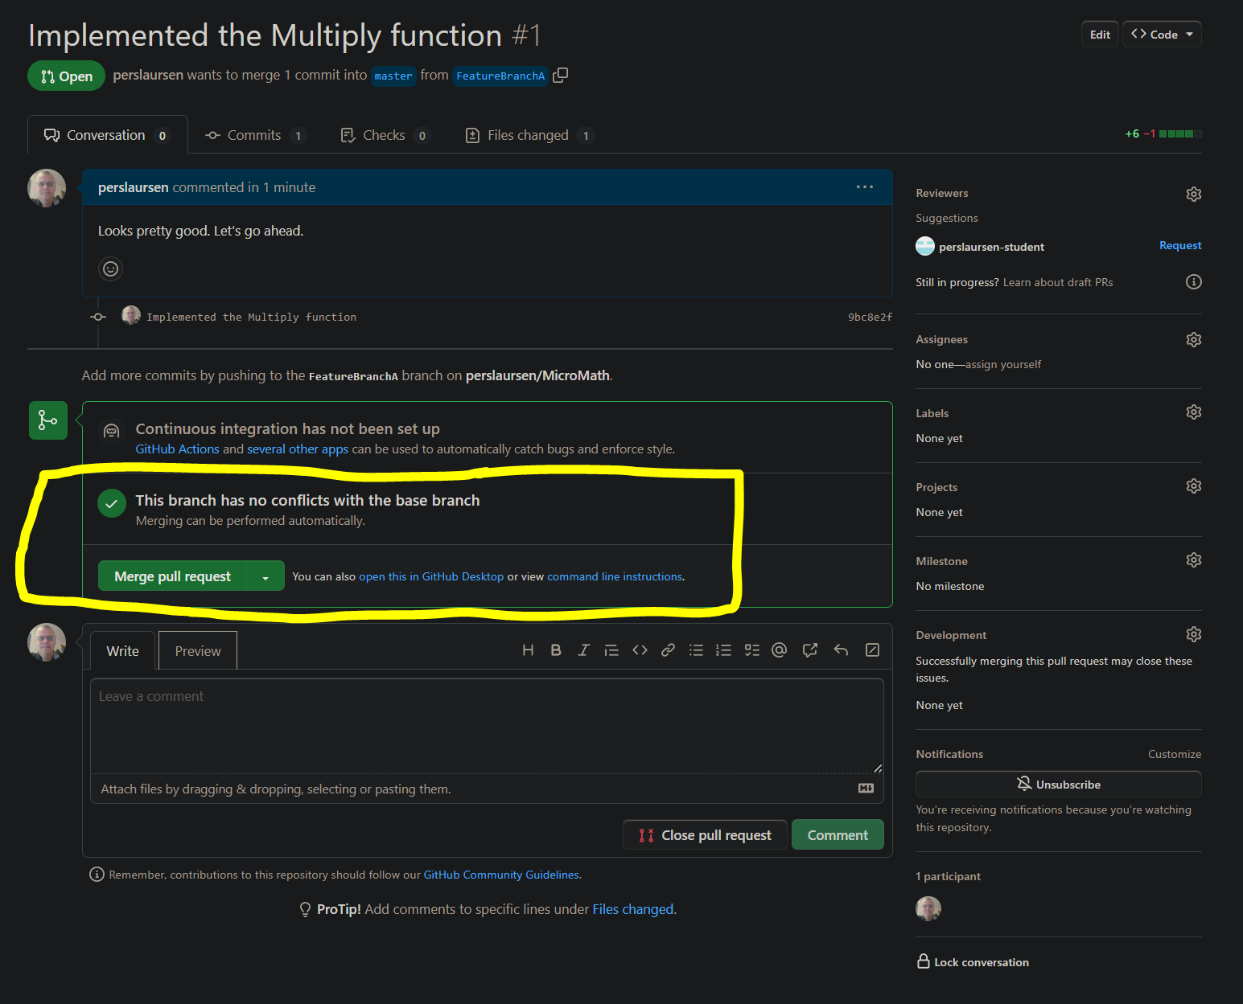

Slide 38
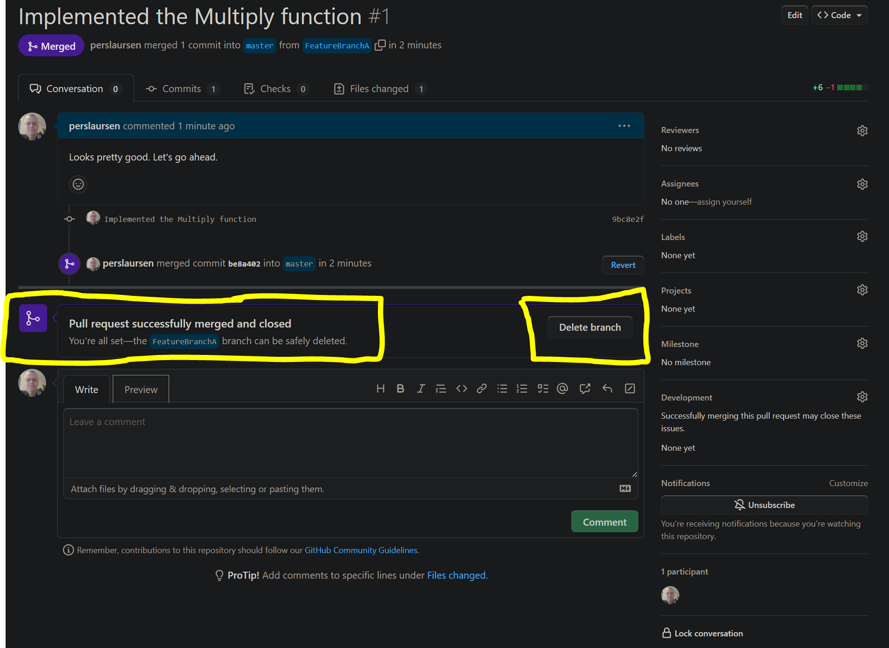

Slide 39
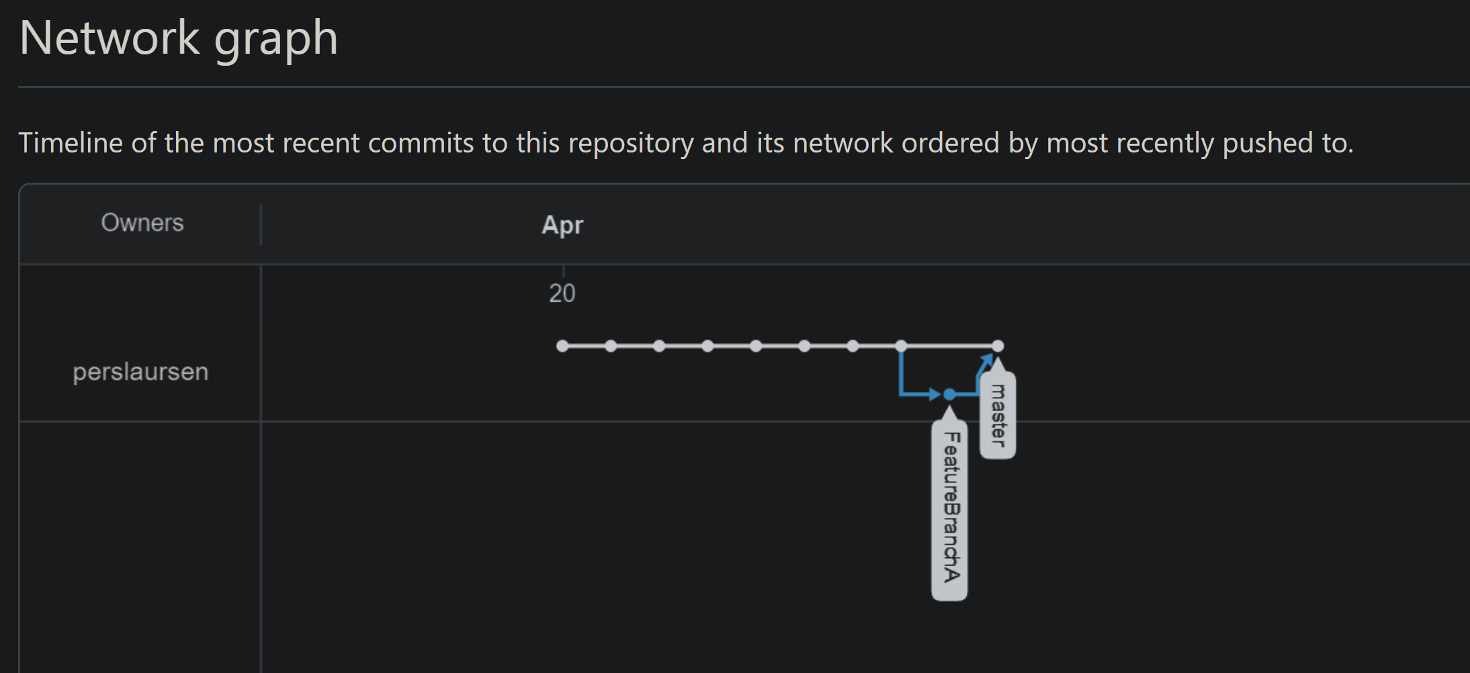

Slide 40
Two persons, using branches
In principle no different than one person using branches
Agree upon a protocol for creating/merging of branches
Who creates pull request, who reviews, what are conditions for accepting a pull request, etc..
BEWARE of the dreaded Merge Conflict…

Slide 41
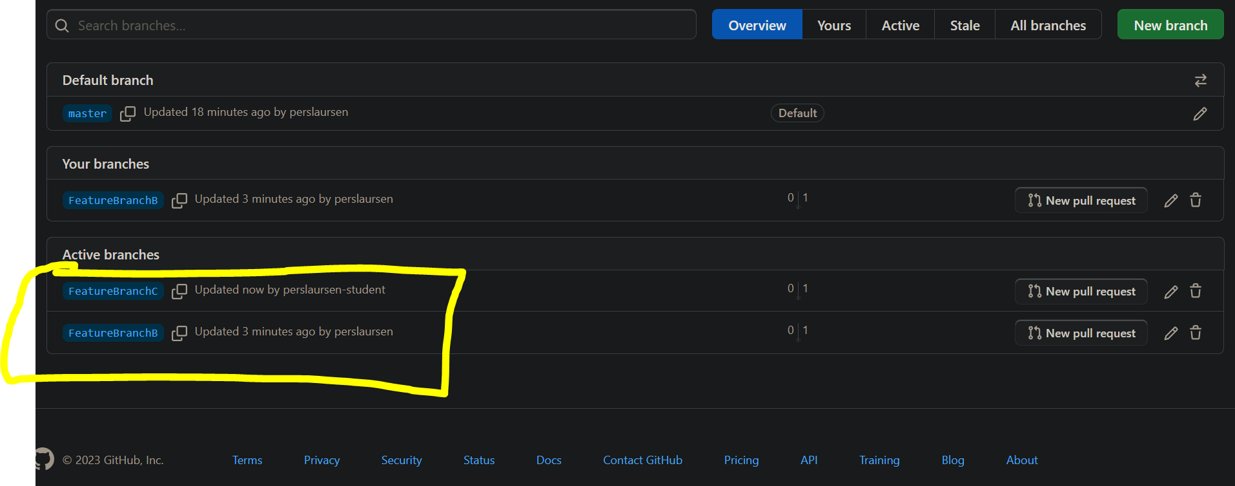

Slide 42
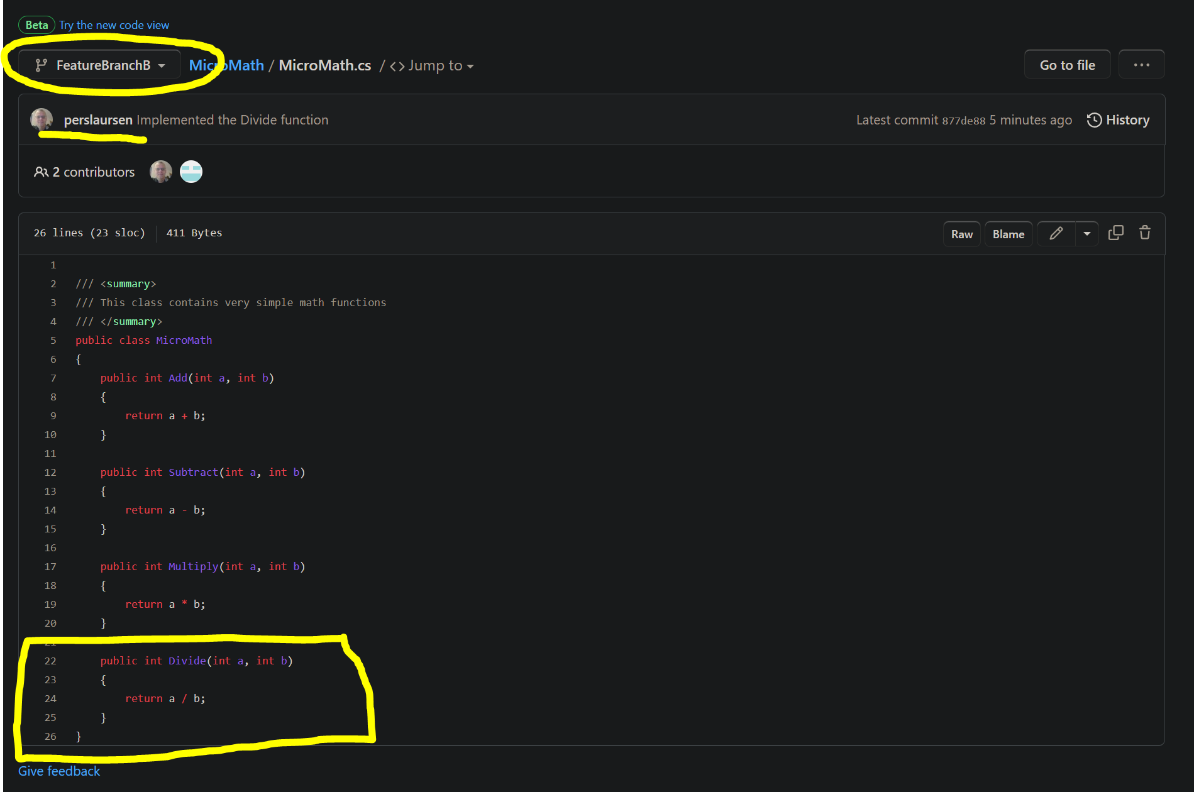

Slide 43
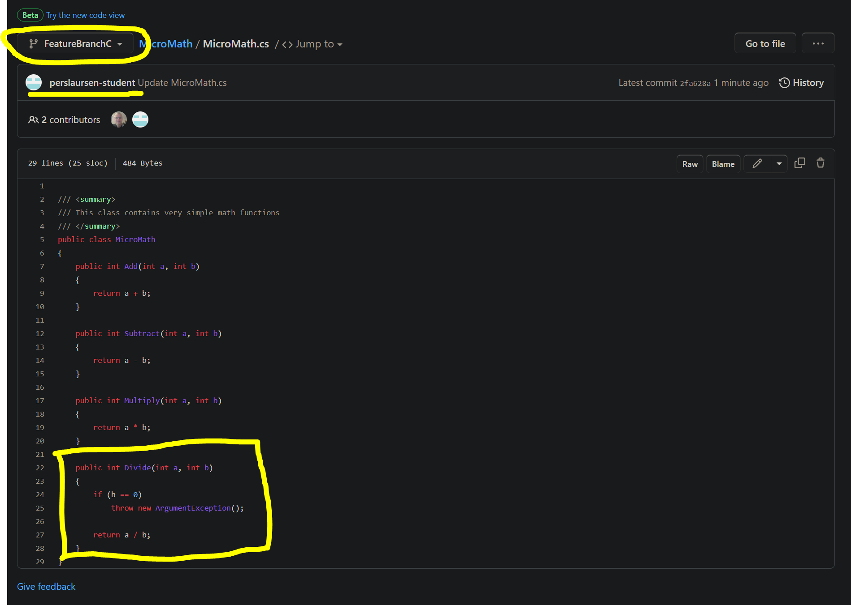

Slide 44
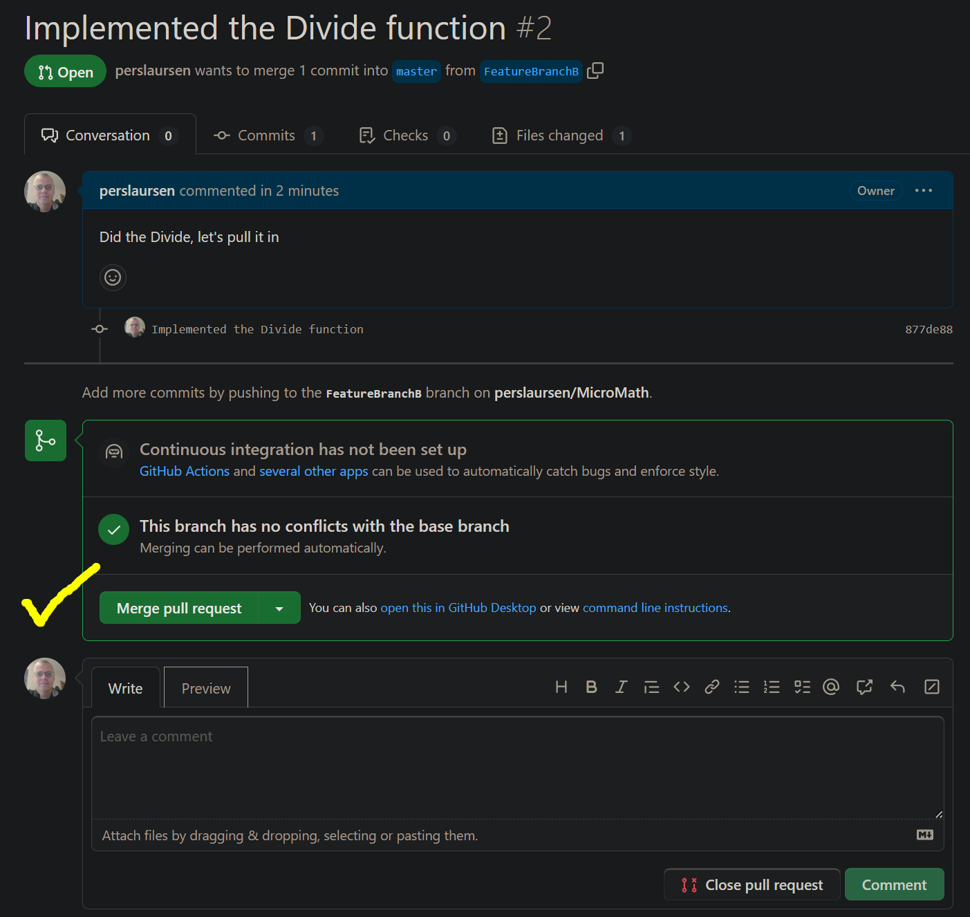

Slide 45
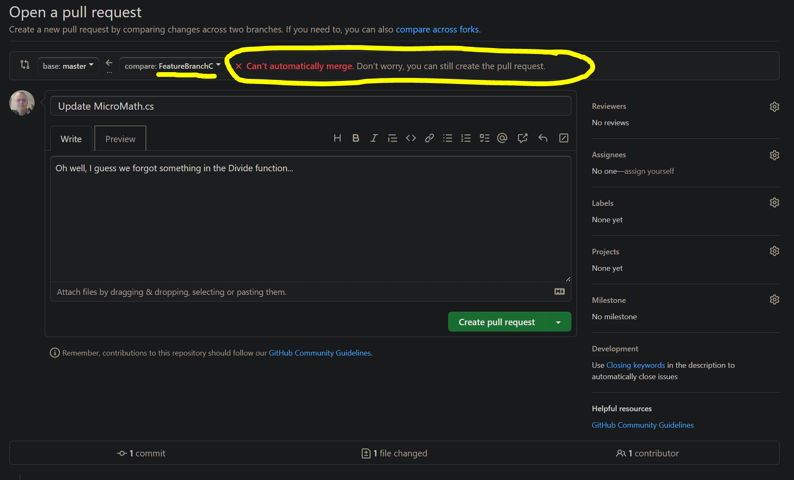

Slide 46
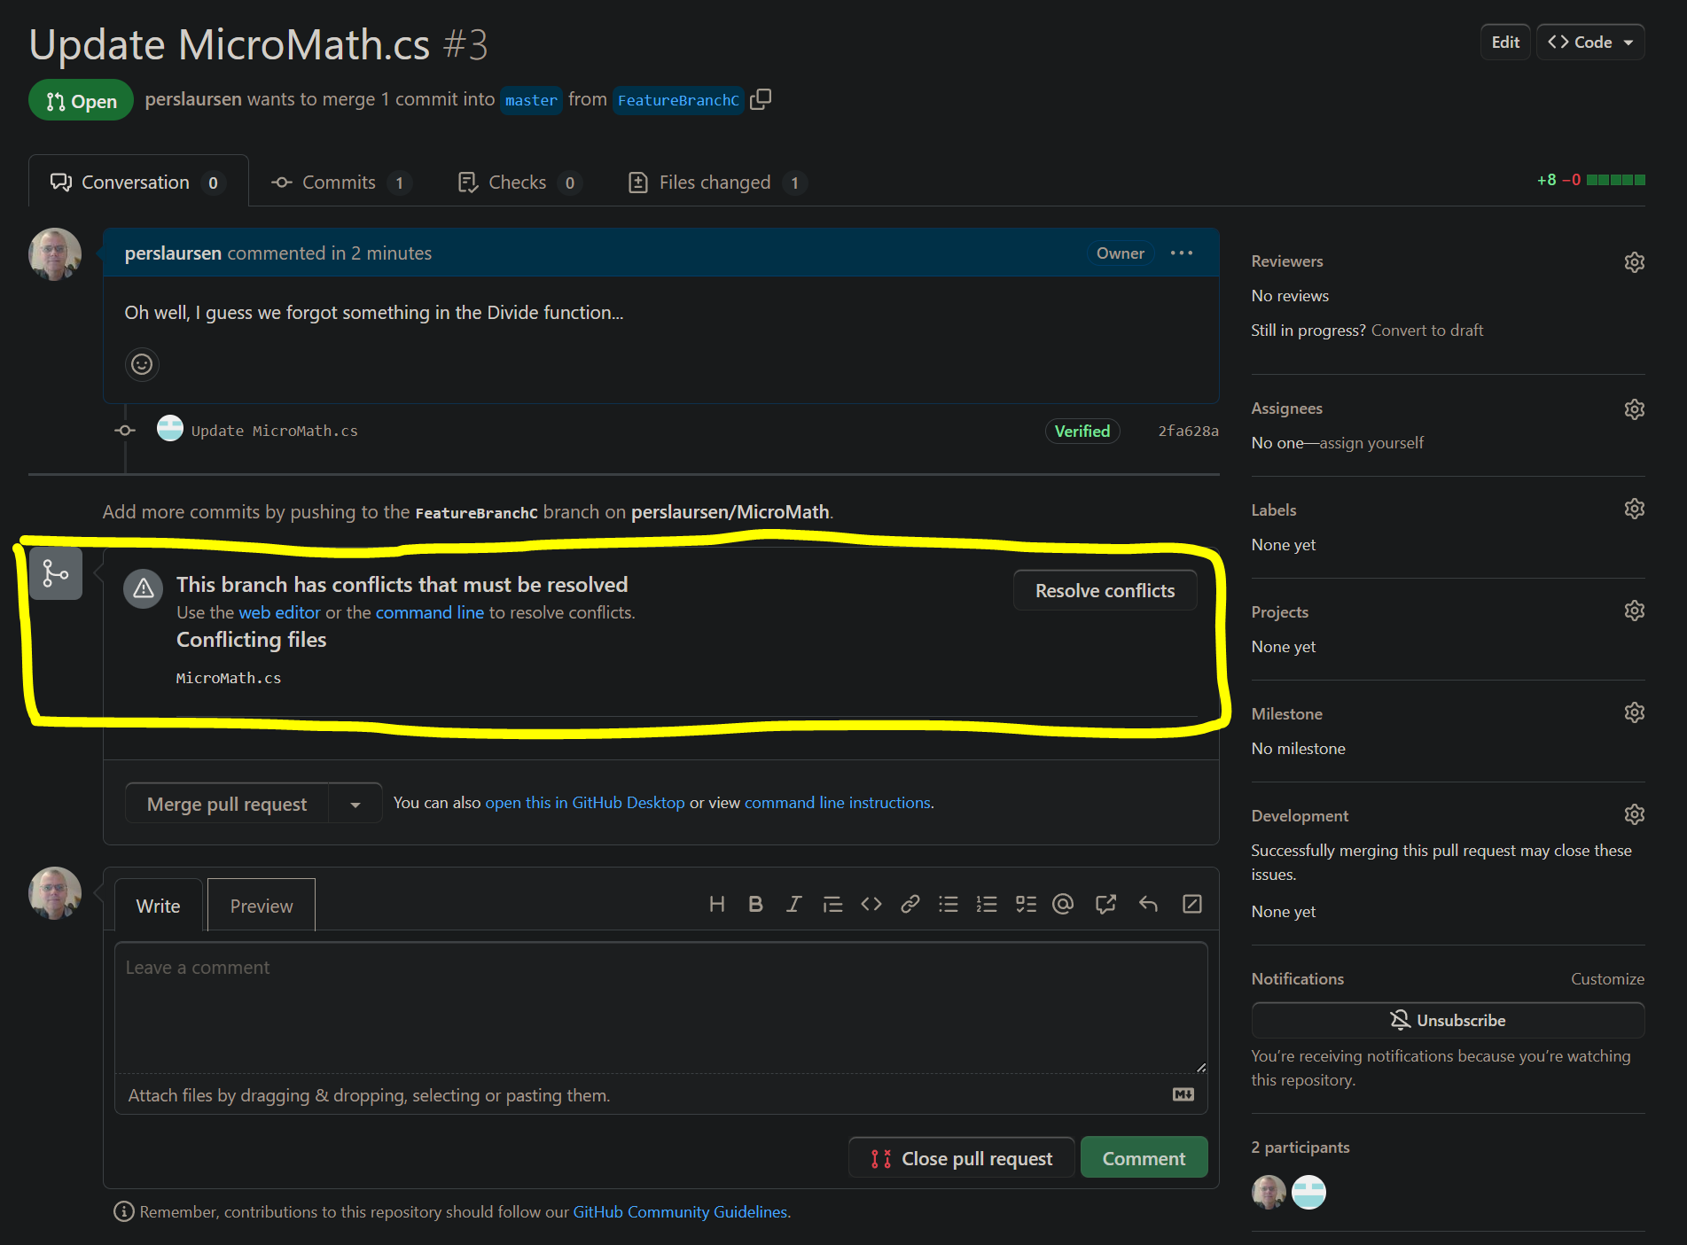

Slide 47
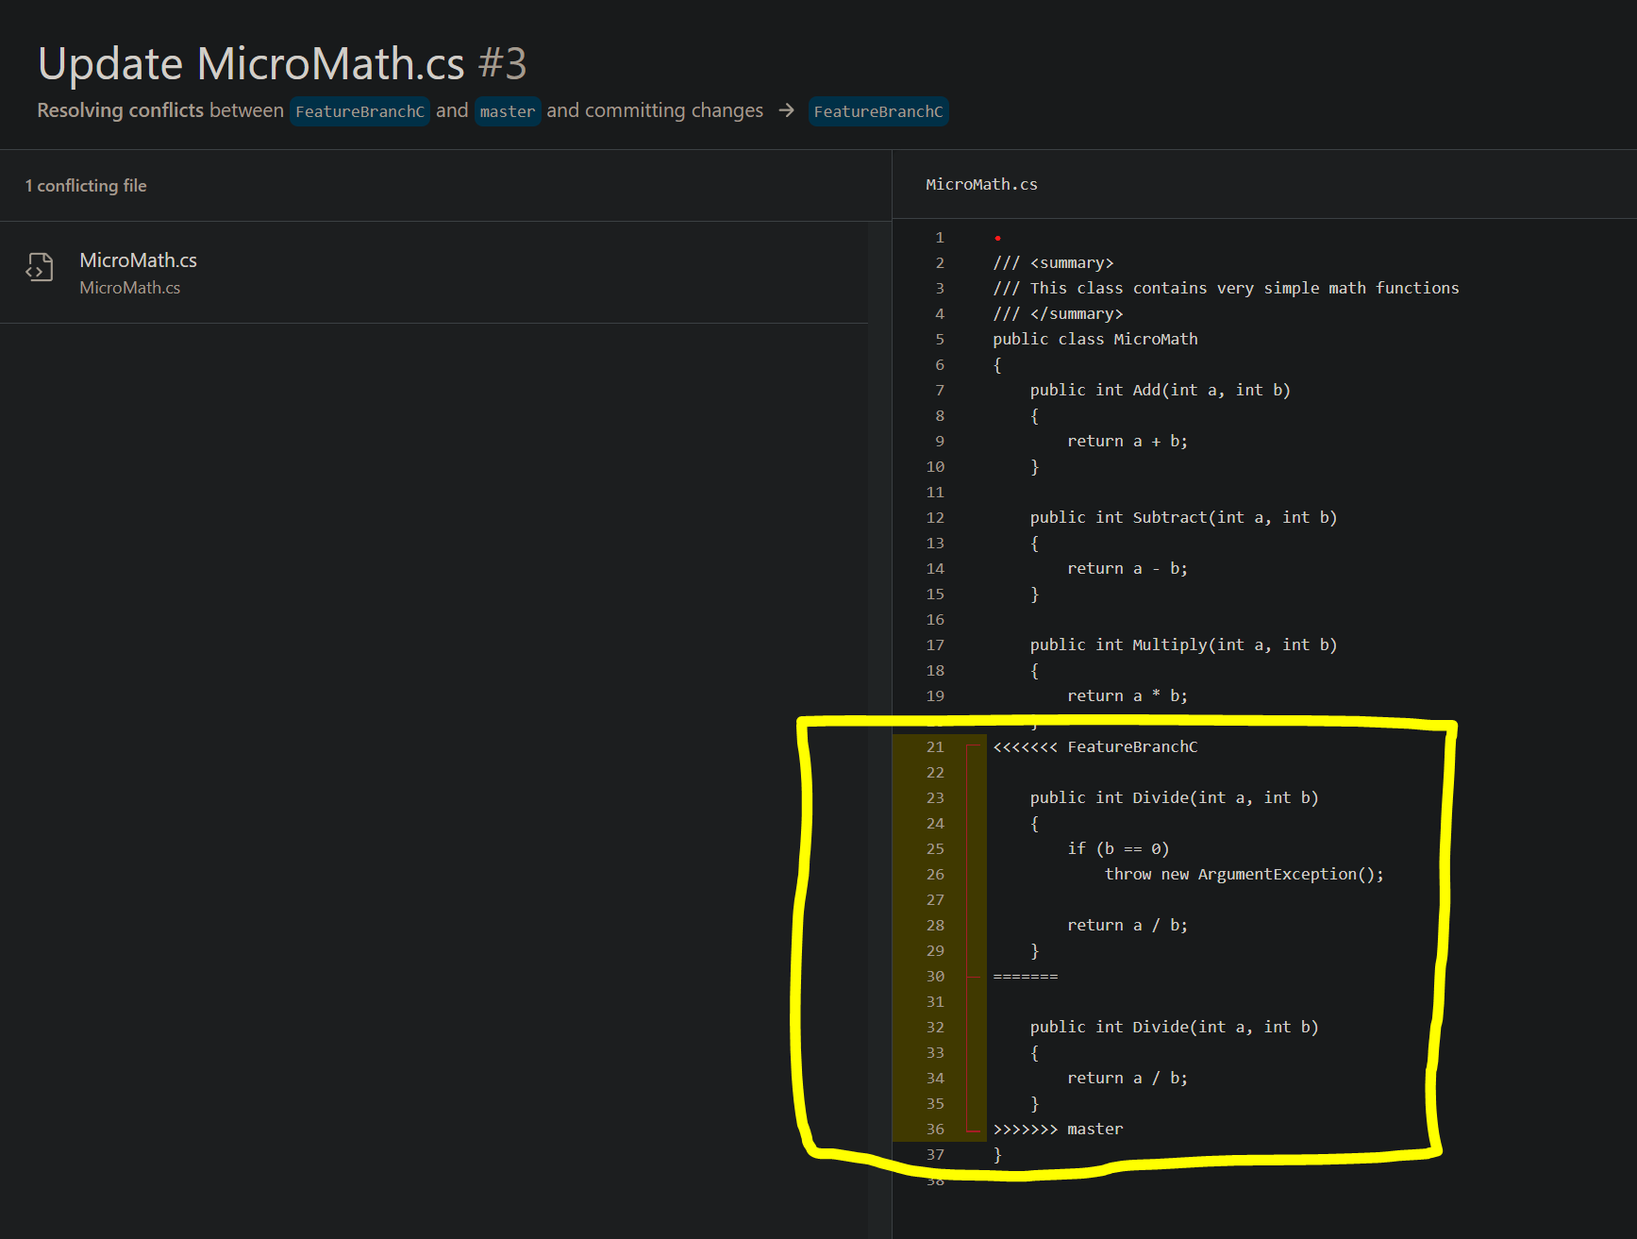

Slide 48
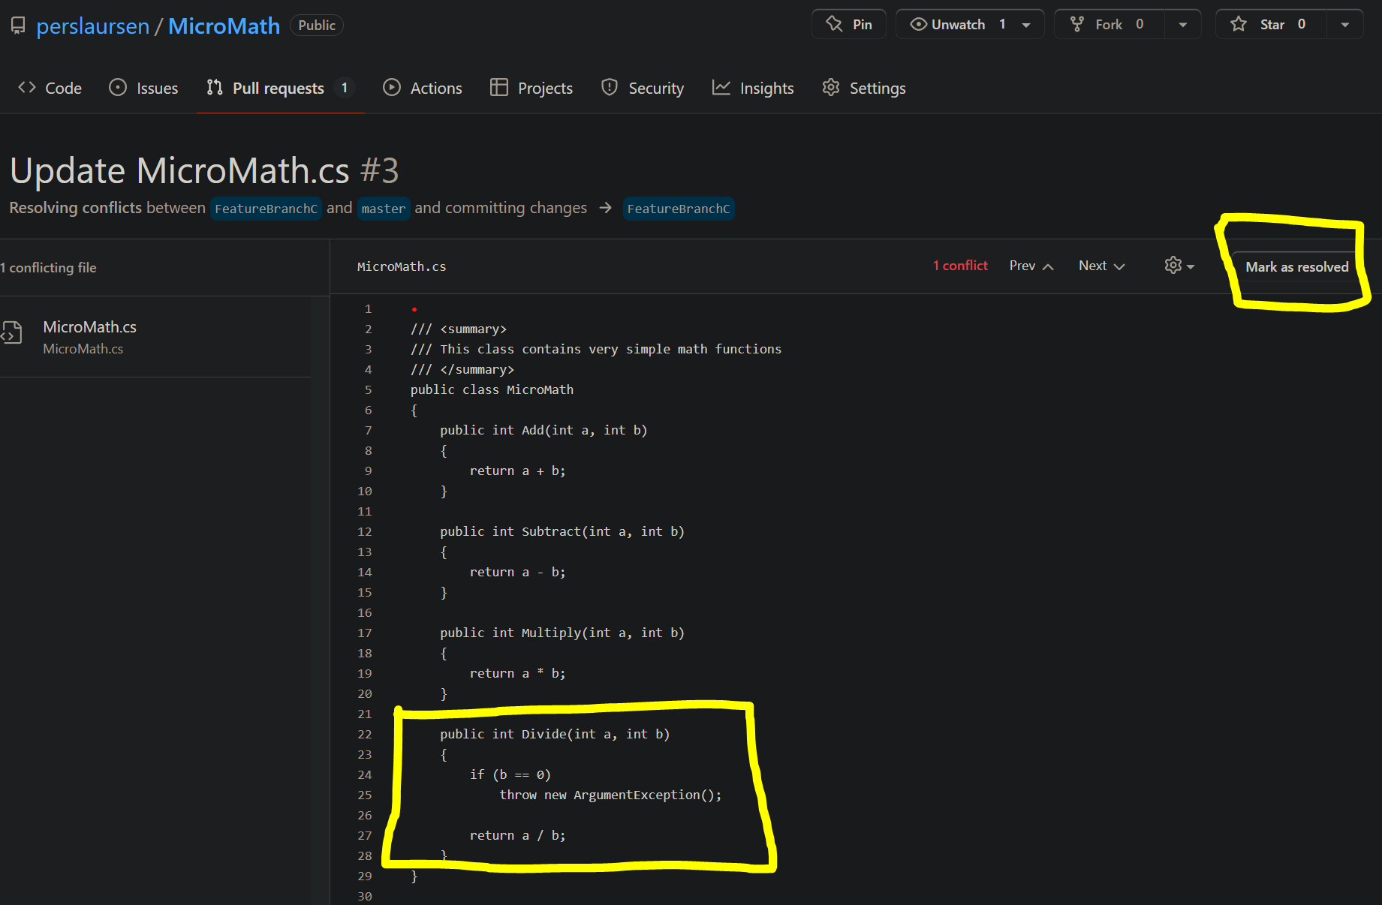

Slide 49
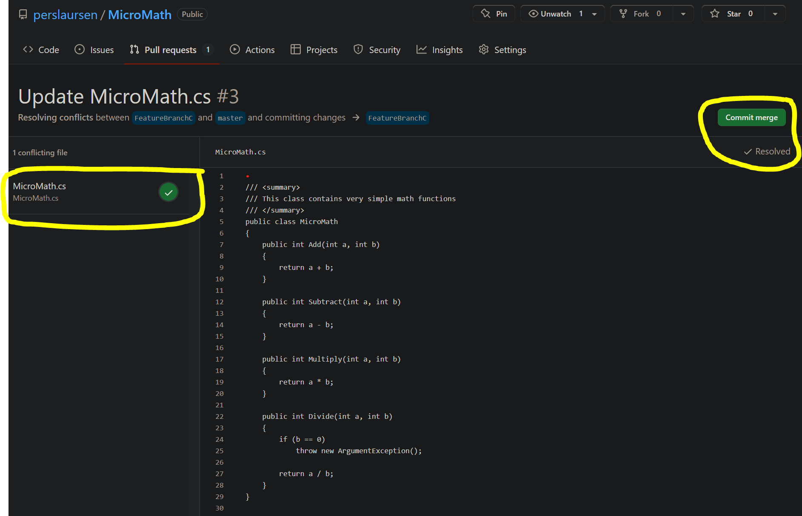

Slide 50
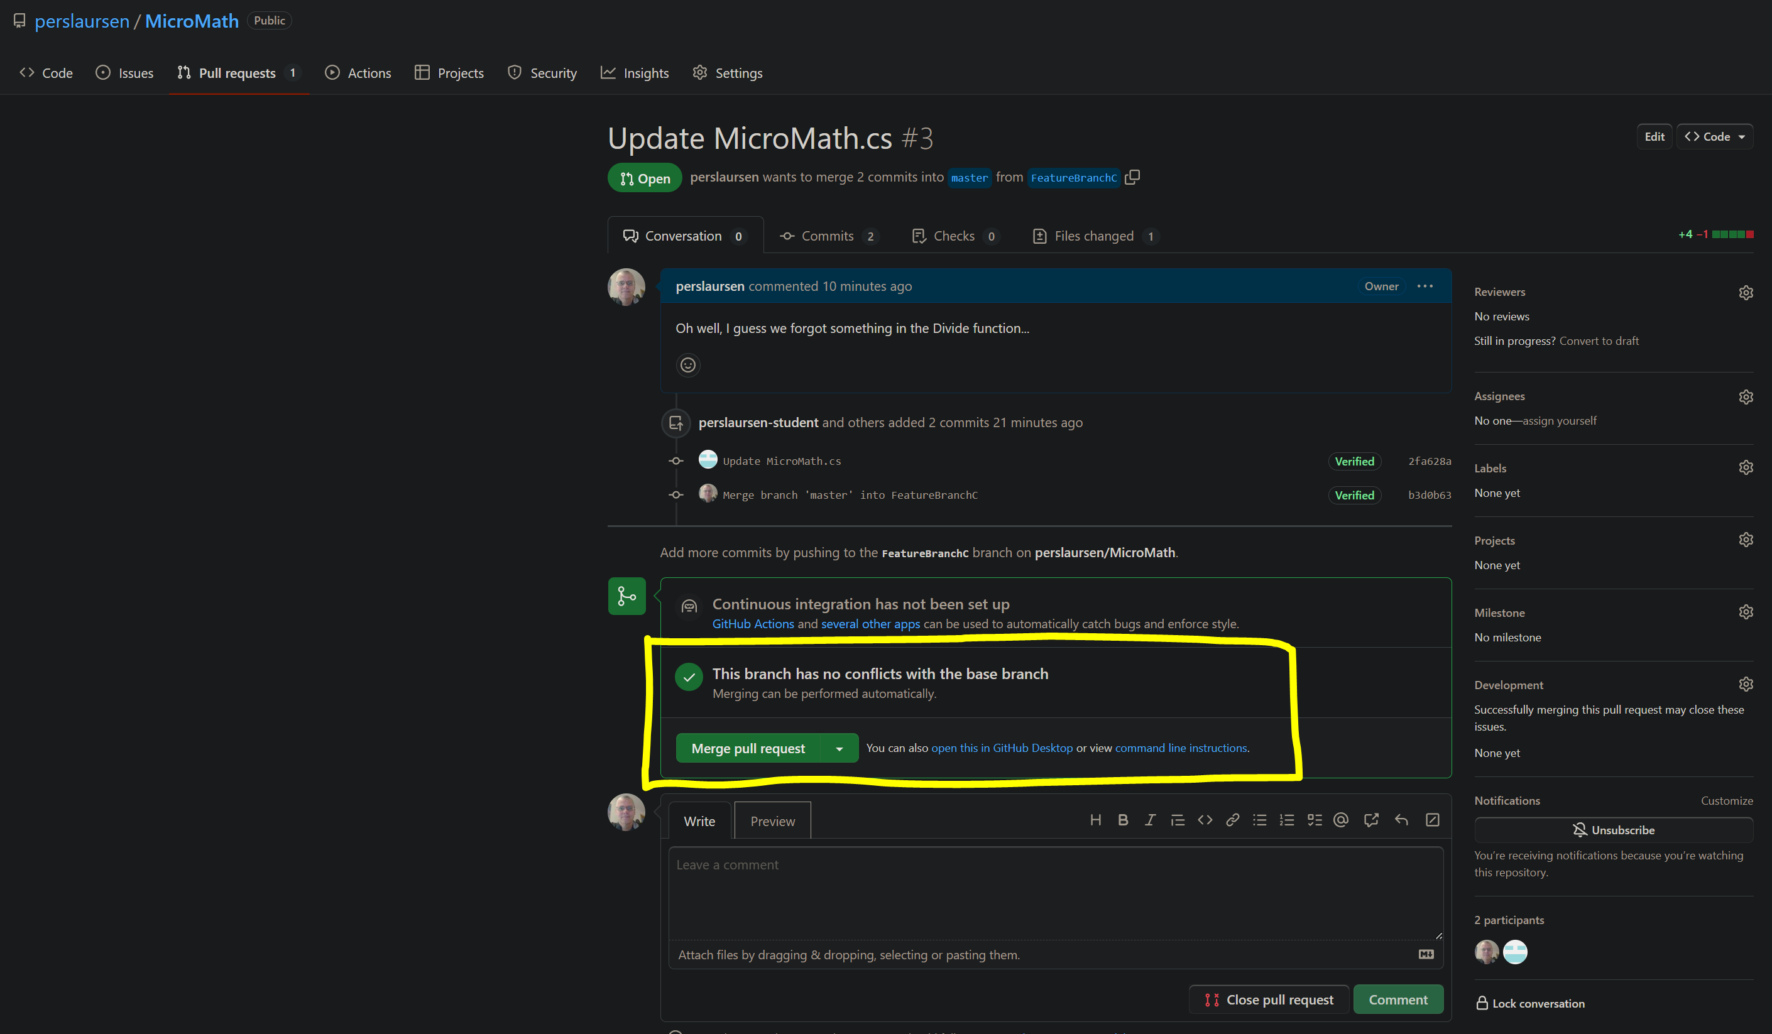

Slide 51
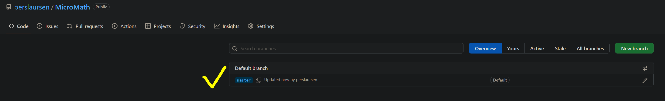
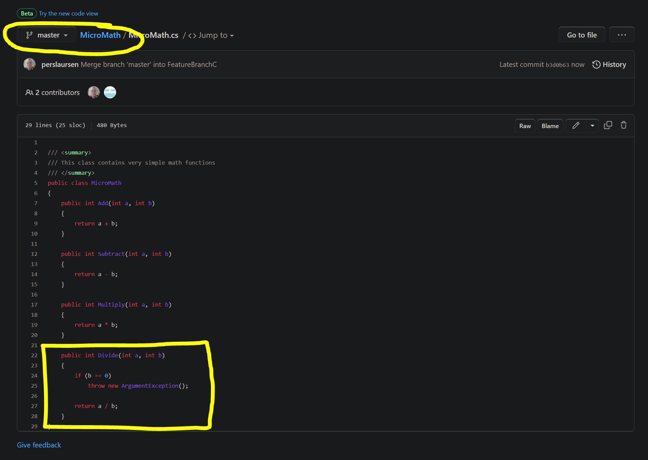

Slide 52
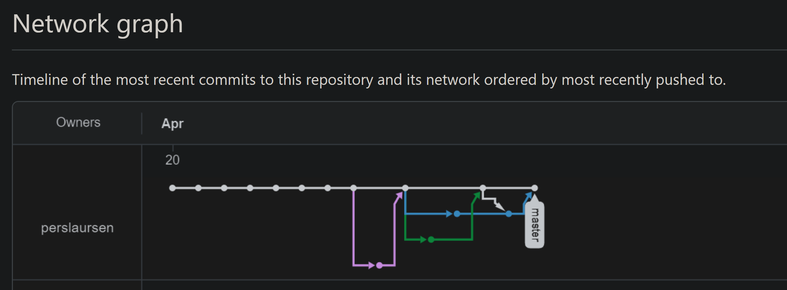

Slide 53
Best advice (once more)…
KEEP IT SIMPLE!!
Figure out a simple scheme for using GitHub, and stick to it.
Only use branches if you feel confident about it, but still keep the number of live branches low.
Merge and delete branches as soon as relevant.
Be very careful about multiple persons working on same files.
GitHub doesn’t replace communication and common sense…

Slide 54
GitHub playbook example
Agree upfront on a simple and realistic protocol
All group members have a GitHub account
One member creates the project in VS, and also creates repository
Creator invites group members to be collaborators
Members typically work on a single feature branch (if you are using branches at all…)
Feature branches are kept as small as possible, and exist as briefly as possible
Never accumulate large sets of unmerged changes!

